Slide 1

Basics of C++

Slide 2
C++
C++ is a collection of subprograms.
Subprogram (or function): collection of statements
When executed, accomplishes something
May be predefined or standard

Slide 3
C++ Language
Programming language: a set of rules, symbols, and special words
Syntax rules: rules that specify which statements (instructions) are legal or valid
Semantic rules: determine the meaning of the instructions
i.e. 2+3*5 VS (2+3)*5 both are syntactically correct but semantically different

Slide 4
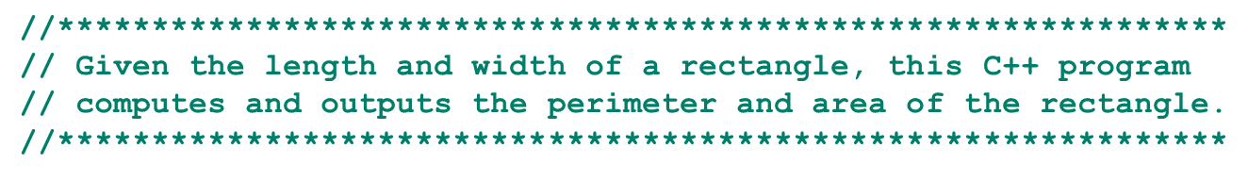
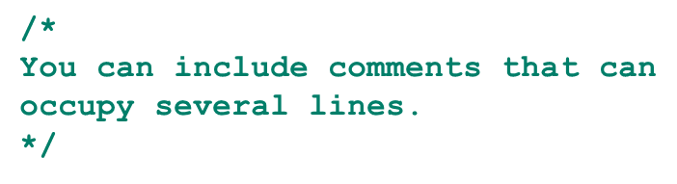
Comments
Comments are for the reader, not the compiler
Two types
Single line: begins with //
Multiple line: enclosed between /* and */

Slide 5
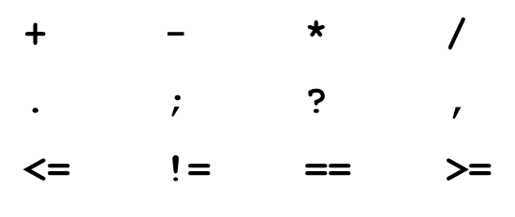
Special Symbols
A token is the smallest individual unit of a program written in any language
C++ tokens include special symbols, word symbols, and identifiers
Special symbols in C++ include:

Slide 6
Reserved Words (Keywords)
Reserved word symbols (or keywords):
Cannot be redefined within a program
Cannot be used for anything other than their intended use
Examples include:
int
float
double
char
const
void
return

Slide 7
Identifiers
An identifier is the name of something that appears in a program
Consists of letters, digits, and the underscore character (_)
Must begin with a letter or underscore
C++ is case sensitive
NUMBER is not the same as number
Two predefined identifiers are cout and cin
Unlike reserved words, predefined identifiers may be redefined, but it is not a good idea

Slide 8
Identifiers
Legal identifiers in C++
first
conversion
payRate
Illegal Identifier | Reason | A Correct Identifier
employee Salary | There can be no space between employee and Salary. | employeeSalary
Hello! | The exclamation mark cannot be used in an identifier. | Hello
one+two | The symbol + cannot be used in an identifier. | onePlusTwo
2nd | An identifier cannot begin with a digit. | second

Slide 9
Data Types
A data type is set of values together with a set of allowed operations
C++ data types fall into three categories:
Simple data type
Structured data type
Pointers

Slide 10
Simple Data Types
Three categories of simple data
Integral: integers (numbers without a decimal)
char, short, int, long, bool, unsigned char, unsigned short, unsigned int, unsigned long
Floating-point: decimal numbers
Enumeration: a user-defined data type

Slide 11
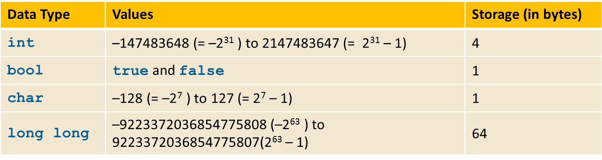
Simple Data Types
Different compilers may allow different ranges of values

Slide 12
int Data Type
Examples
-6728
0
78
+763
Positive integers do not require a + sign
A comma cannot be used within an integer
Commas are only used for separating items in a list

Slide 13
bool Data Type
bool type
Two values: true and false
Purpose: to manipulate logical (Boolean) expressions
true and false
Logical values
bool, true, and false
Reserved words

Slide 14
char Data Type
Data type char is the smallest integral data type
Used for single characters: letters, digits, and special symbols
Each character is enclosed in single quotes
ASCII: American Standard Code for Information Interchange
Each of 128 values in ASCII code set represents a different character
i.e. ‘A’ is represented by 65, ’+’ is represented by 43

Slide 15
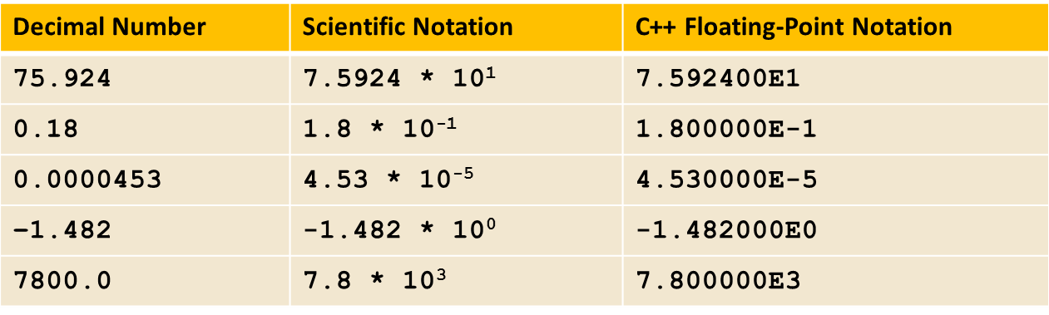
Floating-Point Data Types
C++ uses scientific notation to represent real numbers (floating-point notation)

Slide 16


Floating-Point Data Types
float: represents any real number
Range:
Range:
double: represents any real number
Minimum and maximum values of data types are system dependent
https://replit.com/@btaylan/CISC3142Codes#Lecture-1/floatSize.cpp
Commend to compile on the shell : g++ -o name name.cpp
Commend to run on the shell : ./name

Slide 17
Data Types, Variables, and Assignment Statements
Syntax rule to declare a variable is:
dataType identifier;
int counter;
double interestRate;
char grade;
Assignment statement has the form: variable = expression
interestRate = 0.05;

Slide 18
Arithmetic Operators, Operator Precedence, and Expressions
C++ arithmetic operators include:
+ (addition) , - subtraction , * (multiplication), / (division), % mod (remainder)
When “/” used with integral data types, the result is truncated (no rounding)
+, -, *, and / can be used with integral and floating-point data types
Modulus (%) can only be used with integral data types
https://replit.com/@btaylan/CISC3142Codes#Lecture-1/operations.cpp

Slide 19
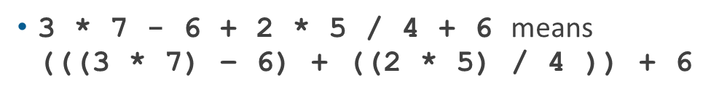
Order of Precedence
All operations inside () are evaluated first
*, /, and % are at the same level of precedence and are evaluated next
+ and - have the same level of precedence and are evaluated last
When operators are on the same level
Operations are performed from left to right (associativity)

Slide 20
Expressions
Integral expression: all operands are integers
Yields an integral result
Example: 2 + 3 * 5
Floating-point (decimal) expression: all operands are floating-point
Yields a floating-point result
Example: 12.8 * 17.5 - 34.50

Slide 21
Expressions
Mixed expression
Has operands of different data types
Evaluation rules
If operator has same types of operands (int-int, float-float)
The operator is evaluated according to the type of the operands
If operator has both types of operands
Integer is changed to floating-point
Result is floating-point
Entire expression is evaluated according to precedence rules
https://replit.com/@btaylan/CISC3142Codes#Lecture-1/mixedTypes.cpp

Slide 22
Type Conversion (Casting)
Implicit type coercion: when the value of one type is automatically changed to another type
i.e. 4 + 3.5
Cast operator (also called type conversion or type casting): provides explicit type conversion
static_cast<dataTypeName>(expression)
https://replit.com/@btaylan/CISC3142Codes#Lecture-1/typeCasting.cpp

Slide 23

String Type
Data type string is a programmer-defined type supplied in Standard C++ library
A string is a sequence of zero or more characters enclosed in double quotation marks
A null (or empty) string is a string with no characters

Slide 24
String Type
Each character has a relative position(index) in the string
Position of first character is 0
The length of a string is the number of characters in it
length of "William Jacob" is 13

Slide 25
Variables, Assignment Statements, and Input Statements
Data must be loaded into main memory before it can be manipulated
Storing data in memory is a two-step process:
Instruct the computer to allocate memory
Include statements in the program to put data into the allocated memory

Slide 26

Allocating Memory with Constants and Variables
Named constant: memory location whose content cannot change during execution
Syntax to declare a named constant:
In C++, const is a reserved word
https://replit.com/@btaylan/CISC3142Codes#Lecture-1/constants.cpp

Slide 27
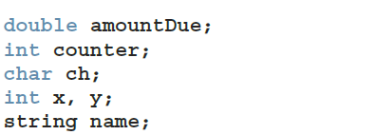
Allocating Memory with Constants and Variables
Variable: memory location whose content may change during execution
Initialized by default
Syntax to declare one or multiple variables:
https://replit.com/@btaylan/CISC3142Codes#Lecture-1/variables.cpp

Slide 28
Putting Data Into Variables
Ways to place data into a variable
1) Use C++’s assignment statement
2) Use input (read) statements

Slide 29
Assignment Statement
Suppose you have the following variable declarations:
int num1, num2;
double sale;
char first;
string str;
Now consider the following assignment statements:
num1 = 4;
num2 = 4 * 5 - 11;
sale = 0.02 * 1000;
first = 'D';
str = "It is a sunny day.";
https://replit.com/@btaylan/CISC3142Codes#Lecture-1/assignment.cpp

Slide 30
Assignment Statement
Given int variables x, y, and z. How is this legal C++ statement evaluated?
x = y = z
The associativity of the assignment operator is from right to left

Slide 31


Input (Read) Statement
cin is used with >> (stream extraction operator) to gather one or more inputs
This is called an input (read) statement
For example, if miles is a double variable:
https://replit.com/@btaylan/CISC3142Codes#Lecture-1/stream.cpp

Slide 32
Increment and Decrement Operators
Increment operator (++): increase variable by 1
Pre-increment: ++variable
Post-increment: variable++
Decrement operator: (--) decrease variable by 1
Pre-decrement: --variable
Post-decrement: variable--
https://replit.com/@btaylan/CISC3142Codes#Lecture-1/incDec.cpp

Slide 33
Output
The syntax of cout << (stream insertion operator):
Expression evaluated and its value is printed at the current cursor position on the screen
A manipulator is used to format the output
Example: endl causes the insertion point to move to beginning of next line
https://replit.com/@btaylan/CISC3142Codes#Lecture-1/output.cpp

Slide 34
Escape Characters
 | Escape Sequence | Description
\n | Newline | Cursor moves to the beginning of the next line
\t | Tab | Cursor moves to the next tab stop
\b | Backspace | Cursor moves one space to the left
\r | Return | Cursor moves to the beginning of the current line (not the next line)
\\ | Backslash | Backslash is printed
\' | Single quotation | Single quotation mark is printed
\" | Double quotation | Double quotation mark is printed
https://replit.com/@btaylan/CISC3142Codes#Lecture-1/escape.cpp

Slide 35
Preprocessor Directives
C++ has a small number of operations
Many functions and symbols needed to run a C++ program are provided as collection of libraries
Every library has a name and is referred to by a header file
Preprocessor directives are processed by the preprocessor program
All preprocessor commands begin with #
No semicolon is placed at the end of these commands

Slide 36


Preprocessor Directives
Syntax to include a header file
Causes the preprocessor to include the header file iostream in the program
Preprocessor commands are processed before the program goes through the compiler

Slide 37
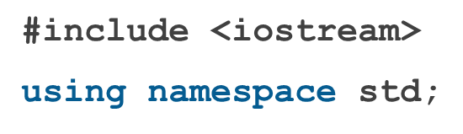
namespace and Using cin and cout in a Program
cin and cout are declared in the header file iostream, but within std namespace
To use cin and cout in a program, use the following two statements:

Slide 38

Using the string Data Type in a Program
To use the string type, you need to access its definition from the header file string
Include the following preprocessor directive:

Slide 39
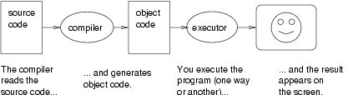
Creating a C++ Program
Source code is comprised of preprocessor directives and program statements
The source code file (source file) contains the source code
The compiler generates the object code (file extension .obj)
Executable code (file extension .exe) results when object code is linked with the system resources

Slide 40



Compound Operators
Simple assignment statement example
Compound assignment statement example
Compound operators:

